Slide 1
Mistra Co-Creating Better Blue (C2B2)
A research programme for a sustainable governance of the Swedish blue economy

Slide 2




The expectations on the ocean are increasing…
Fossil free energy transition
Food security
Effective mobility and transport
Good environmental status
And more…
The real challenge of the coming decade:
Governing multiple demands in increasingly claimed and fragile marine ecosystems.

Slide 3
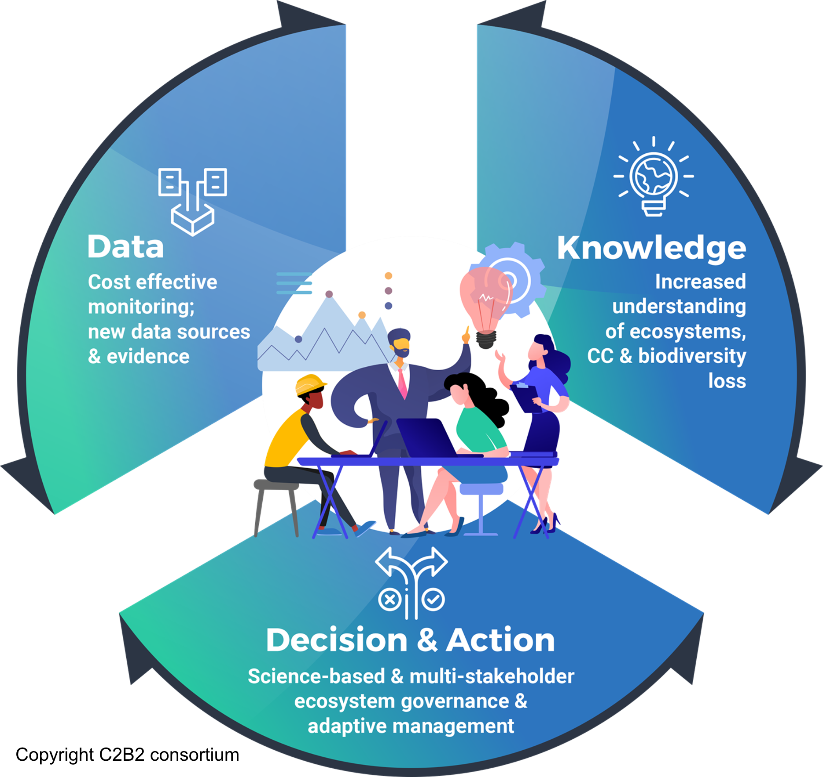
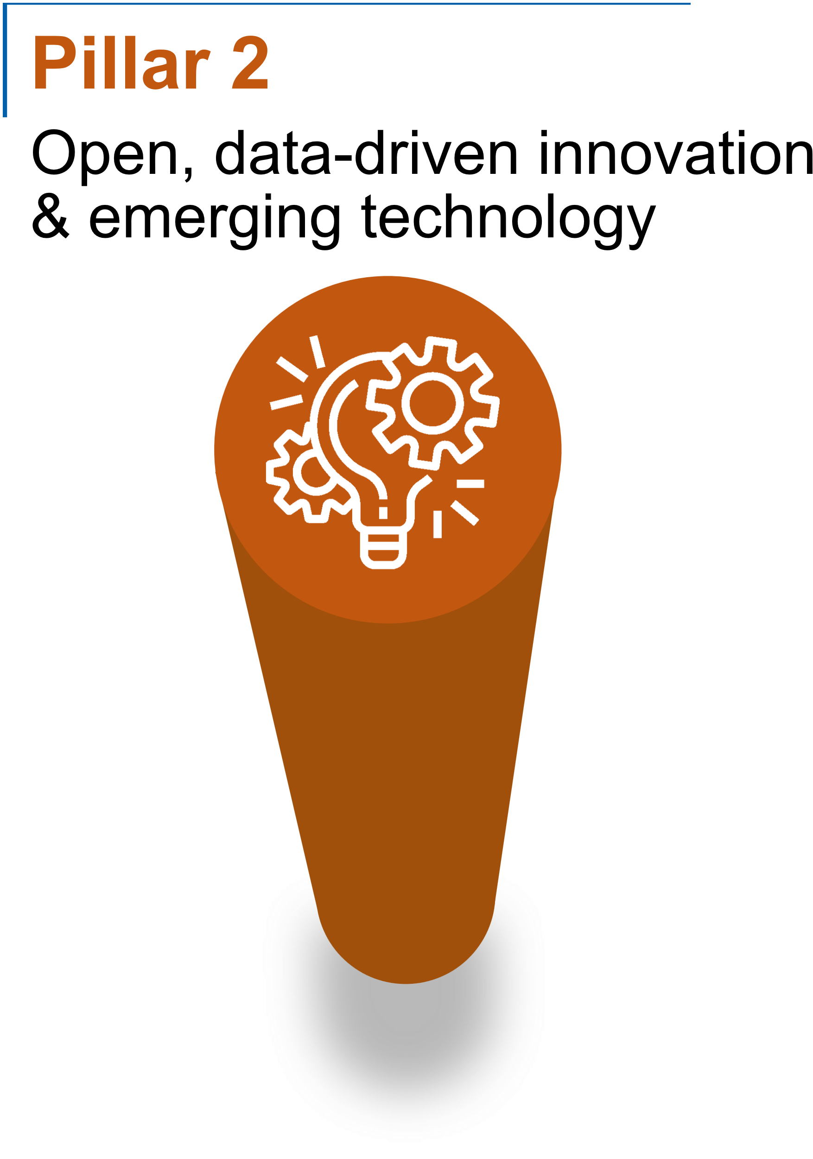
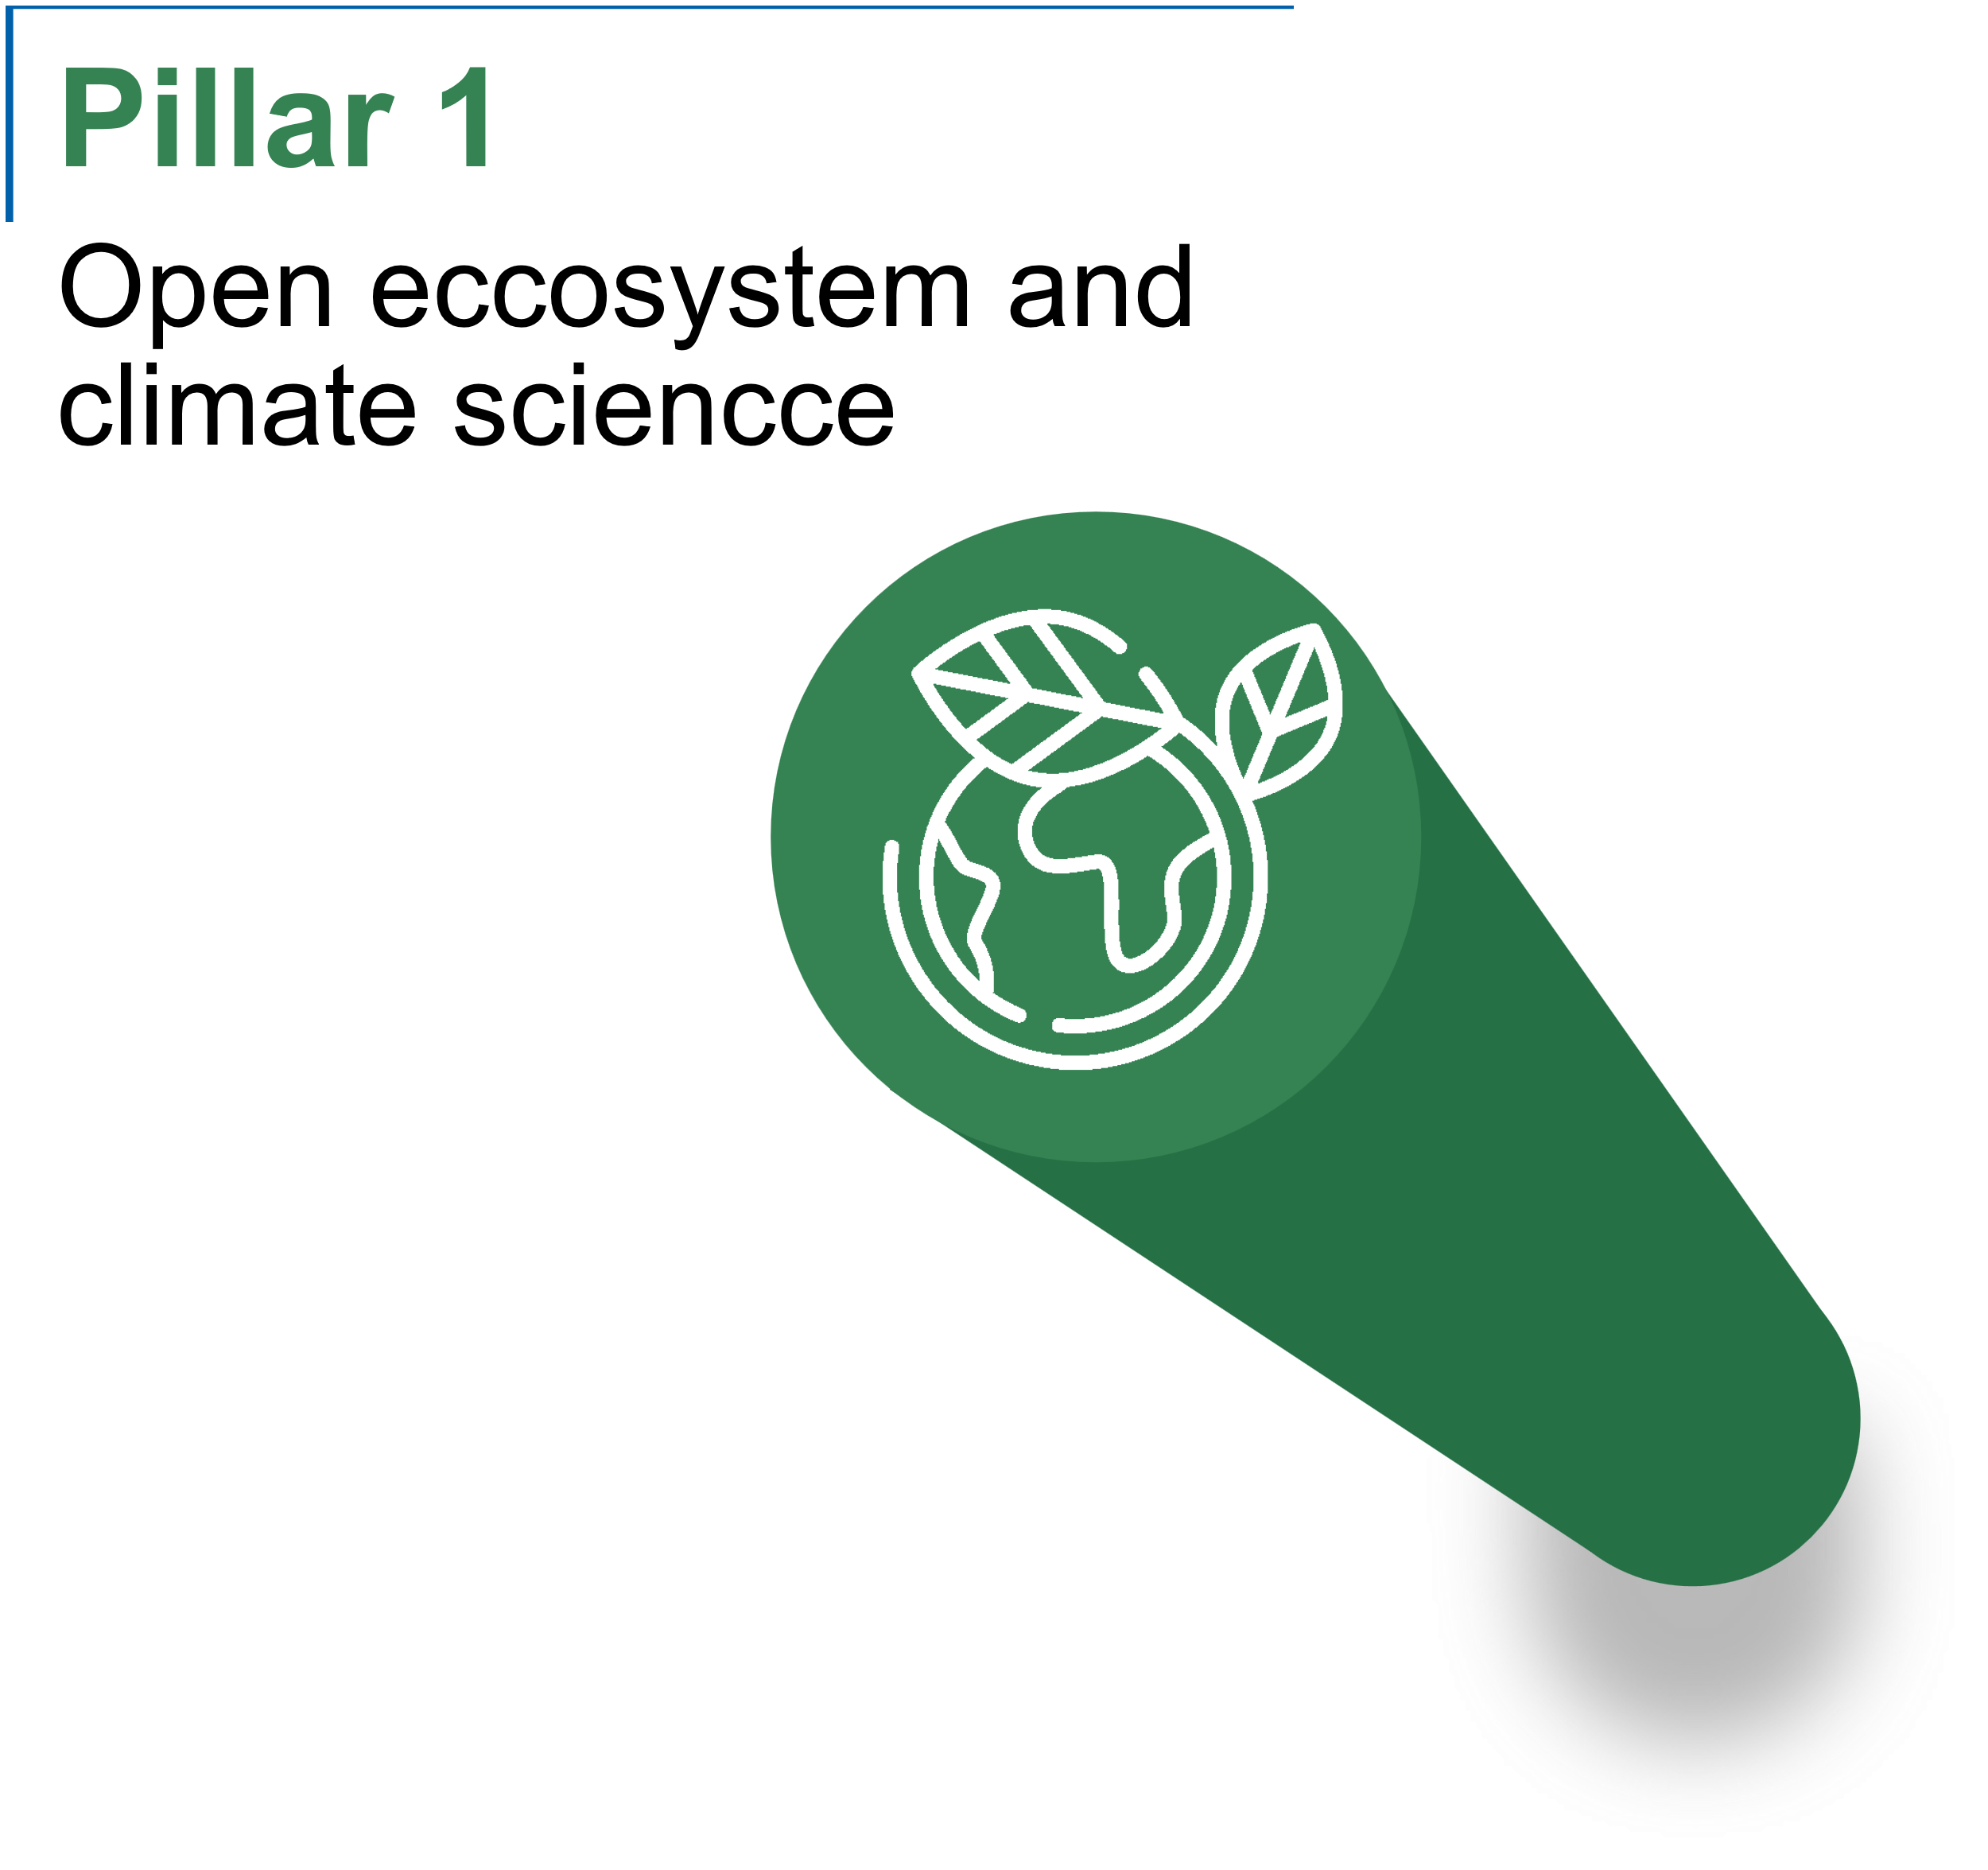
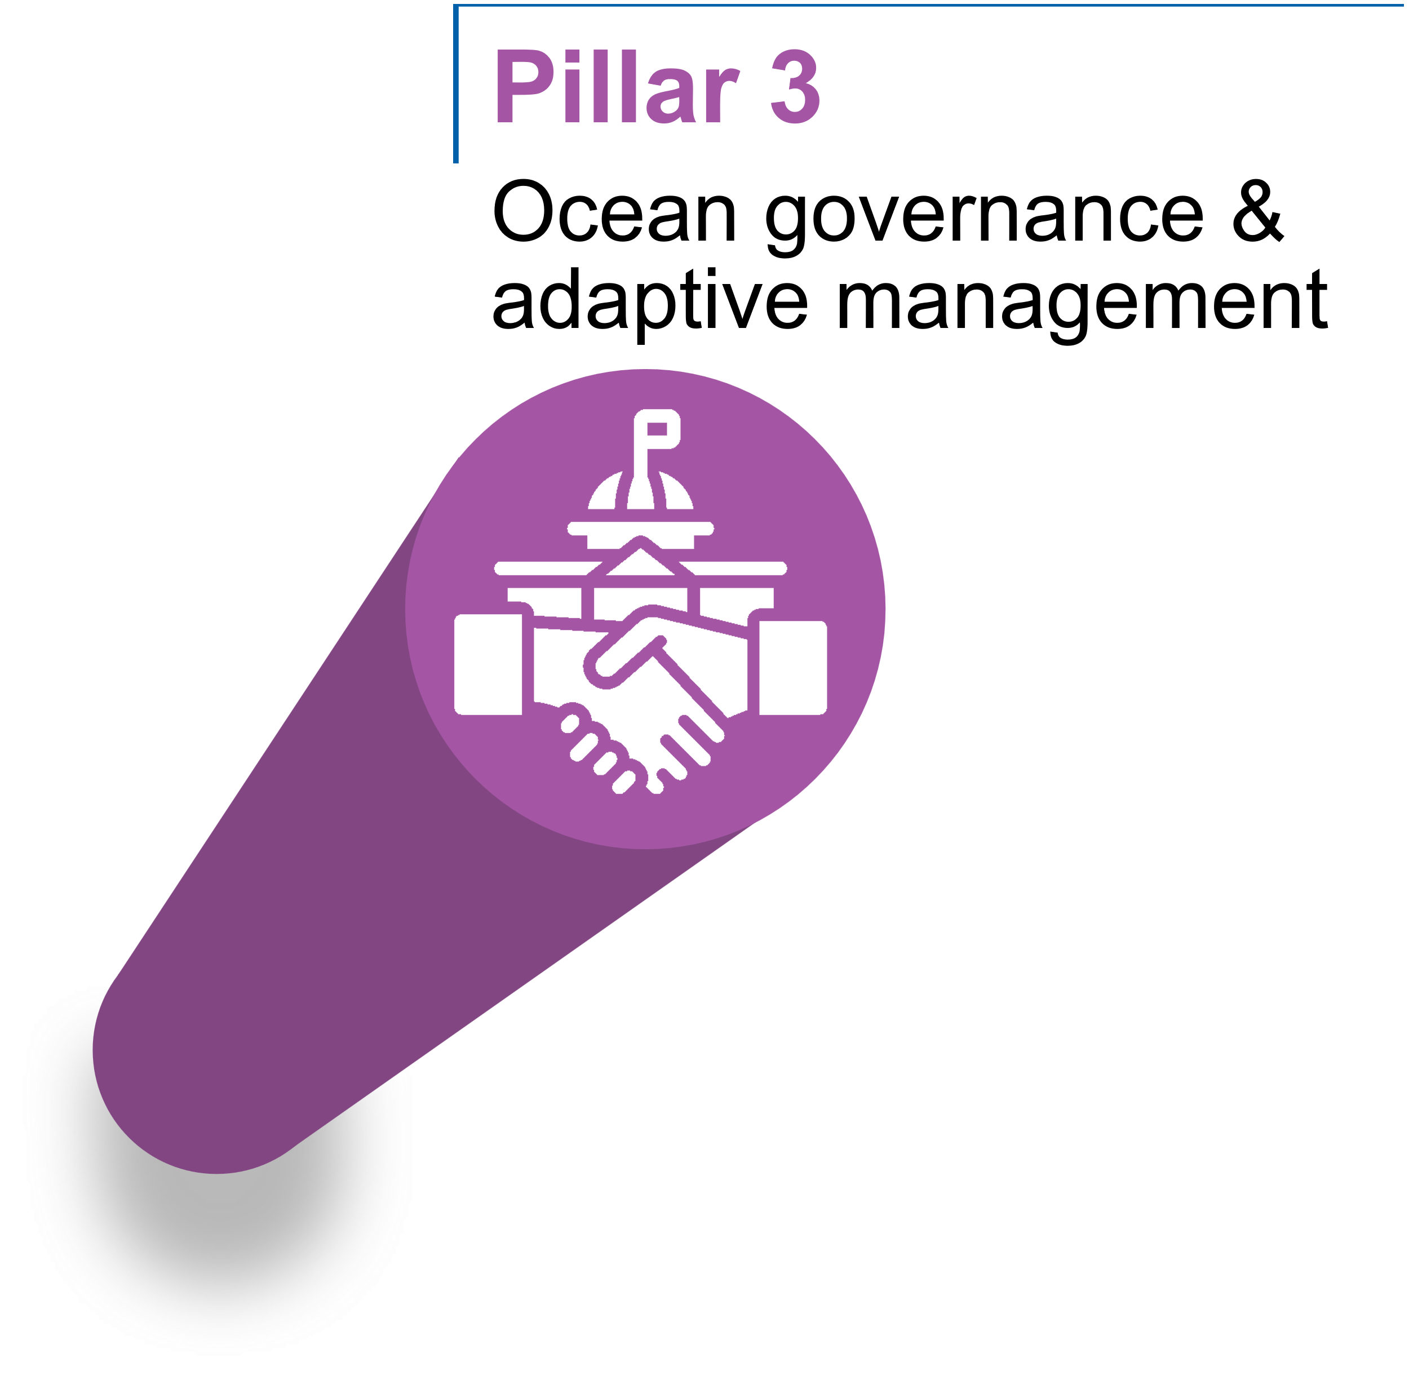
Pillars and concept
From data to knowledge to decisions and action.

Slide 4
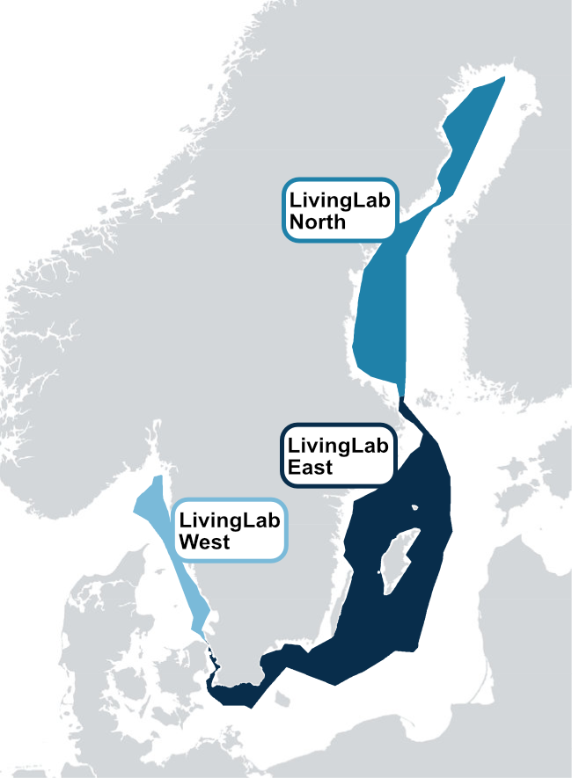




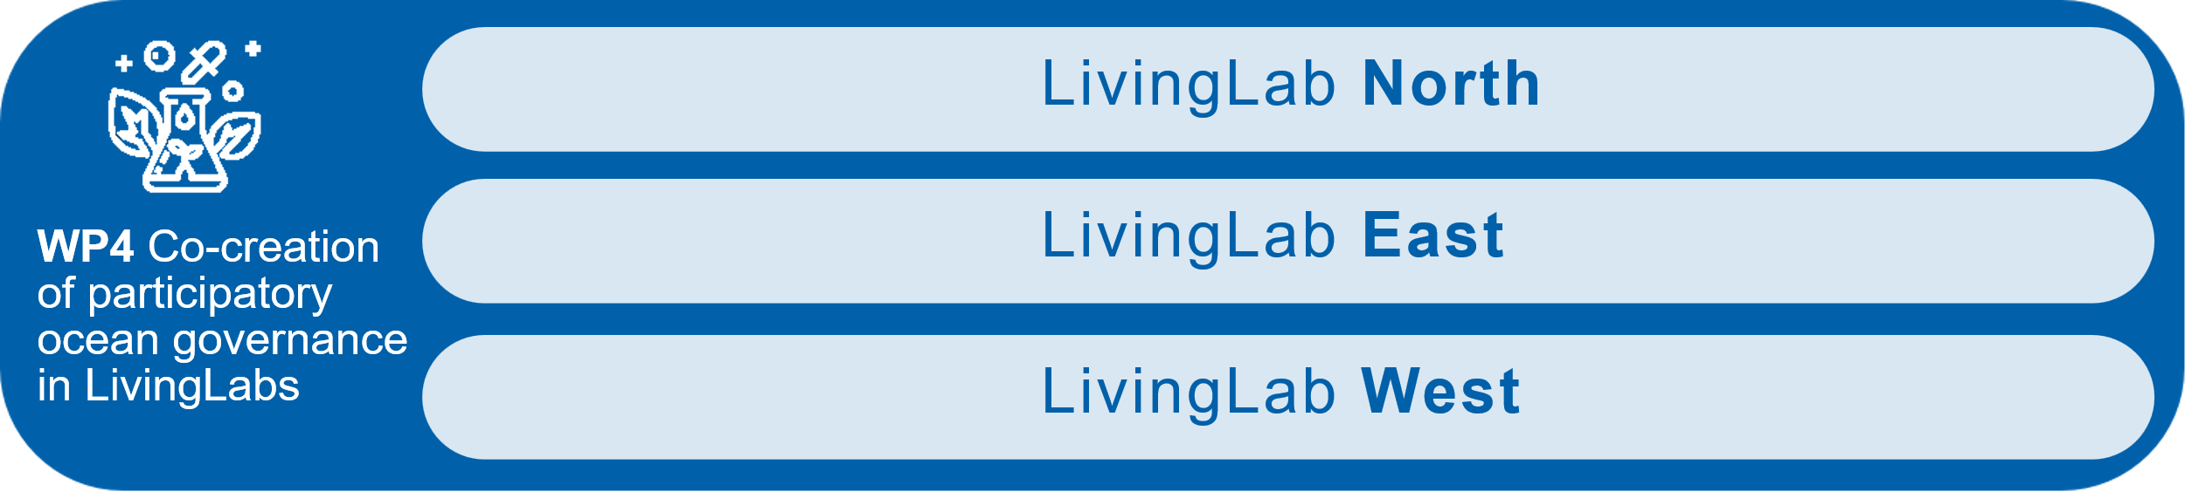
Work packages
From data to knowledge to decisions and action.

Slide 5
C2B2 LivingLabs
The C2B2 LivingLabs are innovation experiments in real life settings in Sweden, made up of actors across multiple sectors and governance levels in marine environments and interested in marine spatial planning.

Slide 6
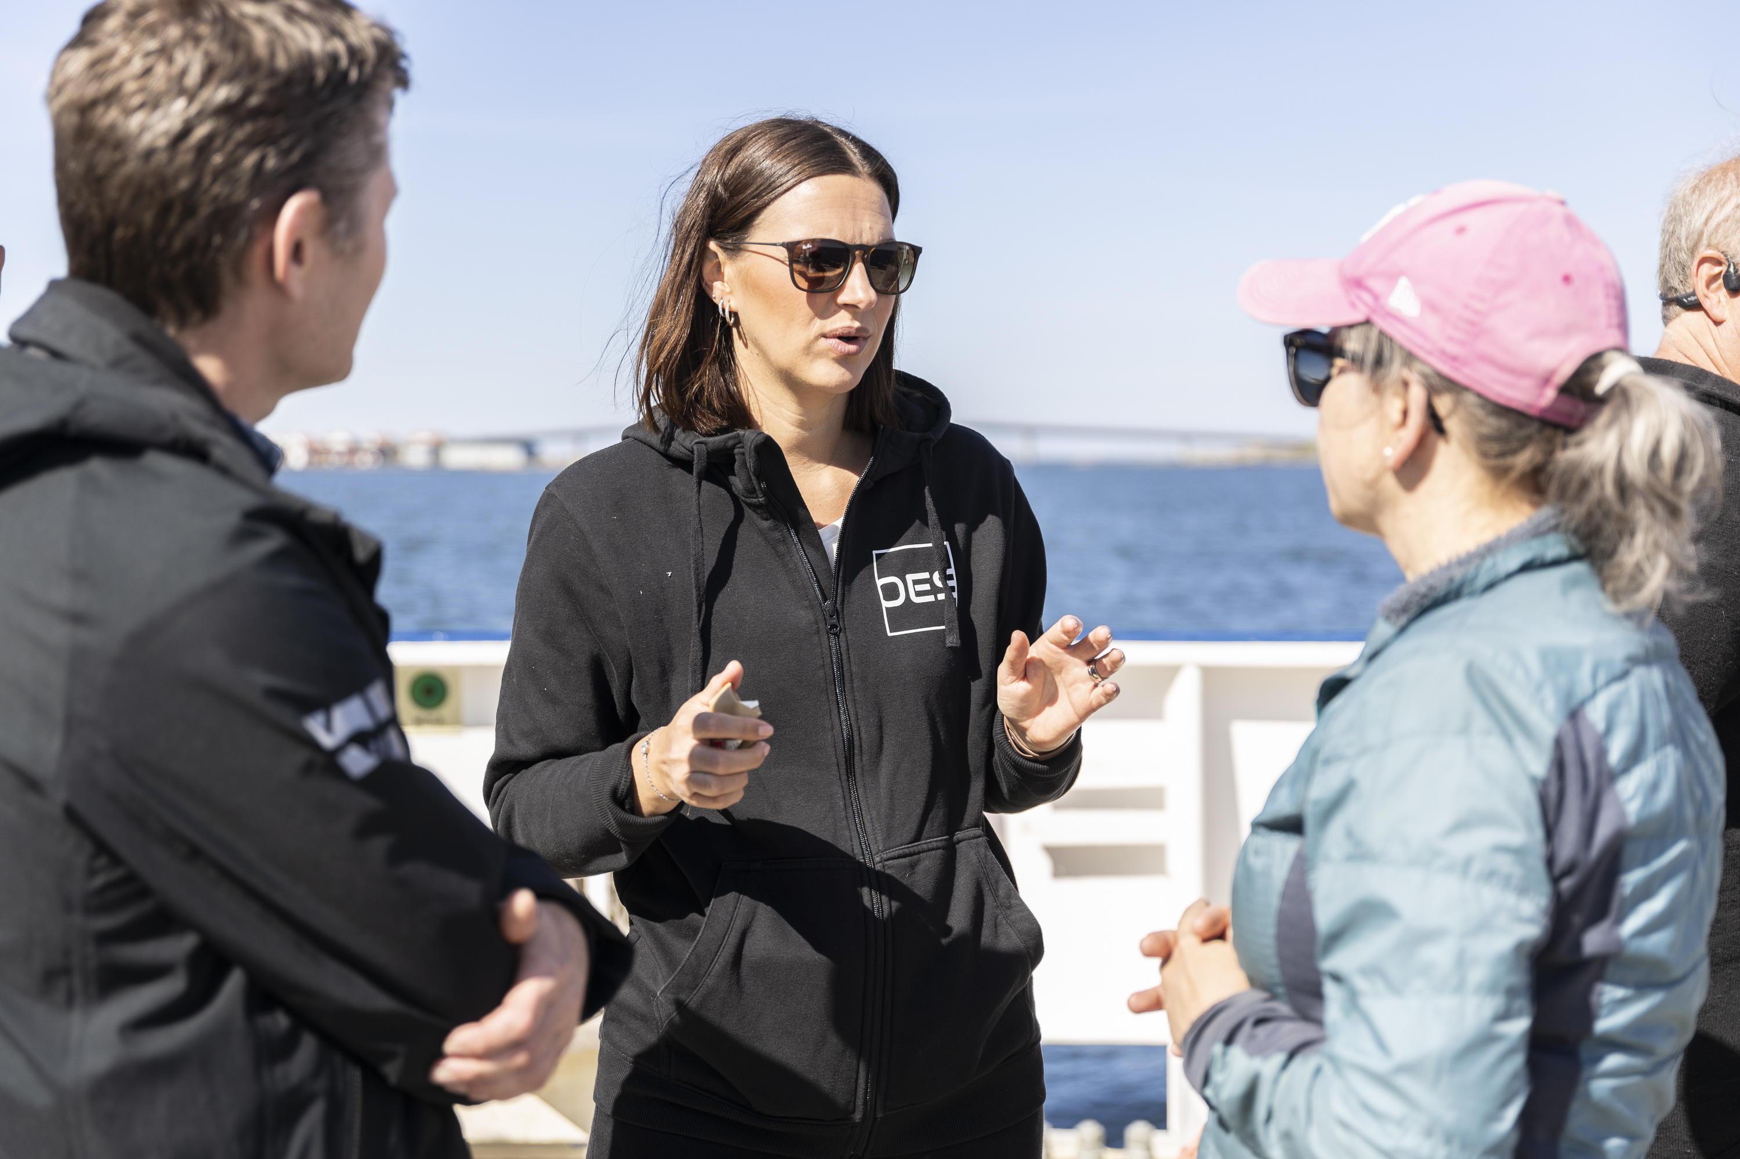
Partners and associated partners
10 partners
(research organisations)
Initially 25 committed stakeholders
(industry, public sector, civil society)

Slide 7



































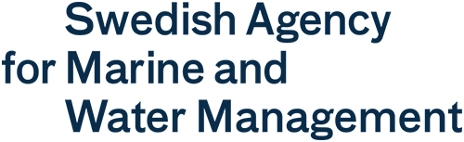




Partners and stakeholders
10 partners
(research organisations)
Initially 25 committed stakeholders
(industry, public sector, civil society)

Slide 8
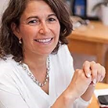
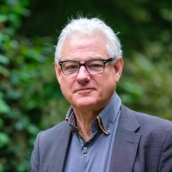
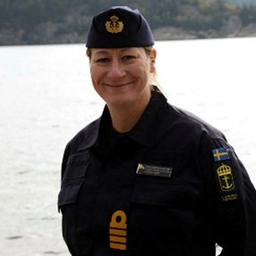

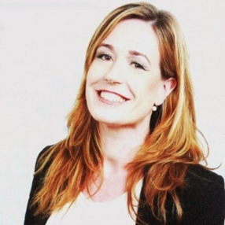



Programme board
Reflects our high ambitions, and our aim of making the C2B2 results replicable outside of Sweden.
Robin Teigland,
Chalmers University of Technology
Jan van Tatenhoven,
Wageningen University & Research
Ewa Skoog Haslum,
Swedish Navy
Richard Hawkins, University of Calgary
Catarina Hedar,
Swedish Agency for Marine and water management

Slide 9
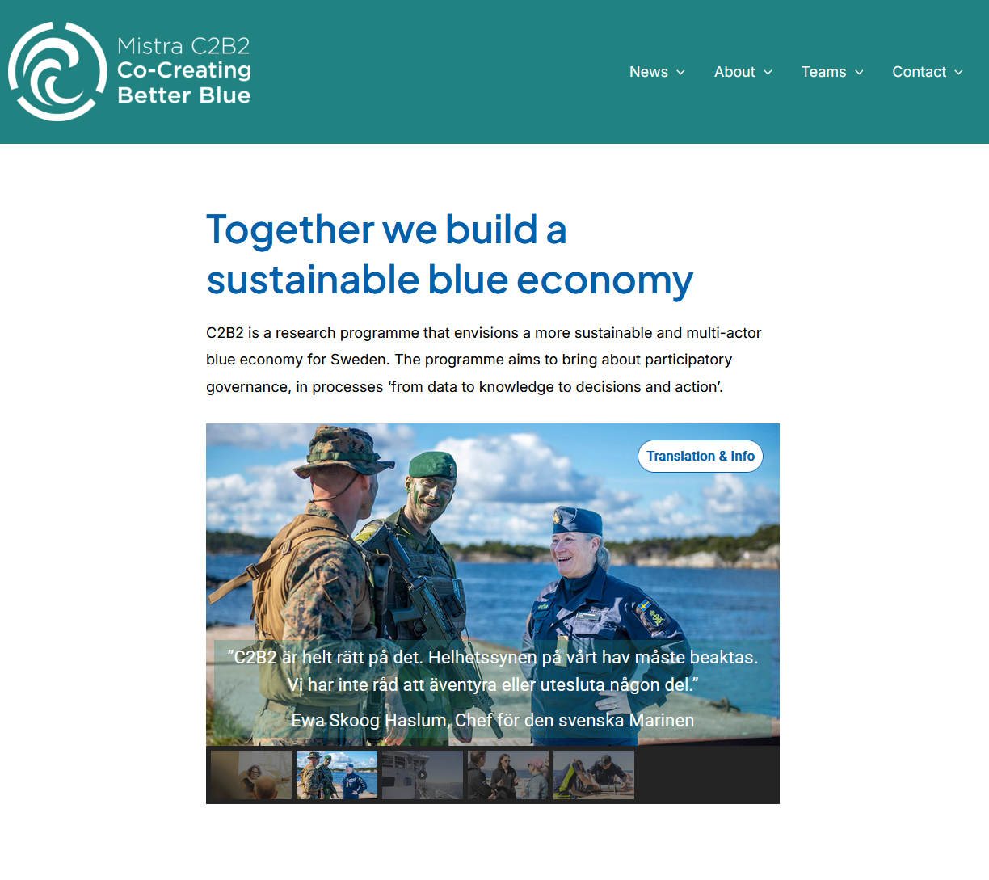

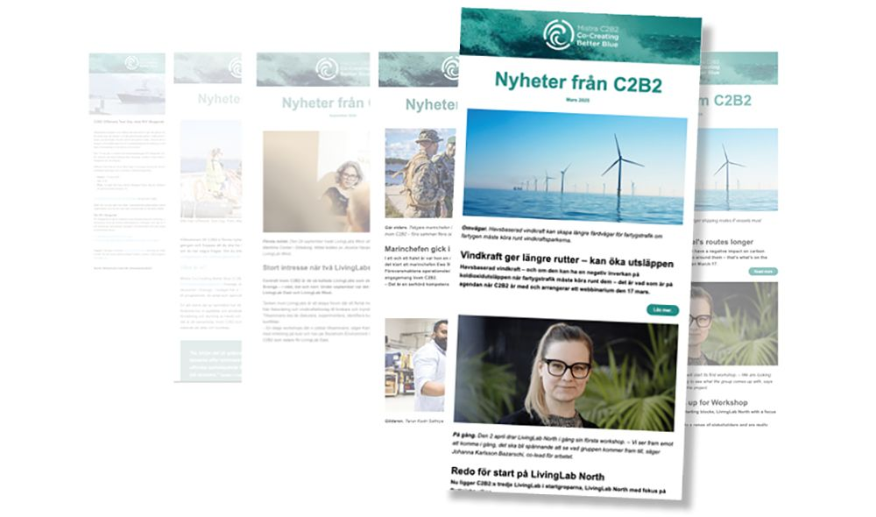

Slide 10
Questions?

